Slide 1
Chapter 3: Transport Layer
UDP

Slide 2
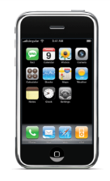


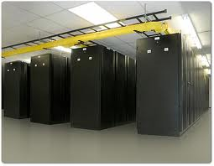
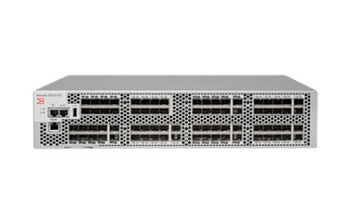

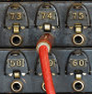
Transport layer functionality
Flow control
Congestion control
Multiplexing via sockets
7: Application
Application services
7: Application
7: Application
Inter-process comm.
Segmentation and reassembly
Error checking
Logical communications
4: Transport
4: Transport
4: Transport
3: Network
3: Network
3: Network
Reliability
In-order delivery
2: Data link
2: Data link
2: Data link
1: Physical
1: Physical
1: Physical
Notes:
How can messages get out of order?: different paths, retransmissions

Slide 3
Multiplexing and Demultiplexing
UDP
TCP
s = socket.socket(socket.AF_INET, socket.SOCK_DGRAM)
s.bind((‘127.0.0.1’, 5000))
s = socket.socket(socket.AF_INET, socket.SOCK_STREAM)
s.bind ((‘127.0.0.1’, 80))
s.listen(1)
conn, addr = s.accept()
http://en.wikipedia.org/wiki/ List_of_TCP_and_UDP_port_numbers
Packets demuxed by:
Destination IP
Destination port
Packets from (153.90.118.46,3541) and (128.111.52.235,5502) would go to the same socket
Packet demuxed by:
Destination IP
Destination port
Source IP
Source port
Packets from (153.90.118.46,3541) and (128.111.52.235,5502) would go different sockets
UDP sockets identified
(dst_IP:dst_port) tuple
TCP sockets identified
(src_IP:src_port, dst_IP:dst_port) four-tuple
Notes:
Why not all the ports below 1024 are used?
Why have this reserved range?
Port scanning
Why have the different demultiplexing mechanisms in UDP and TCP? (hint: DNS runs on UDP, web servers on TCP)
Support for threading on TCP (or different connection for each request in non-persistent HTTP) – different service per client
UDP: same service per client with lower state

Slide 4
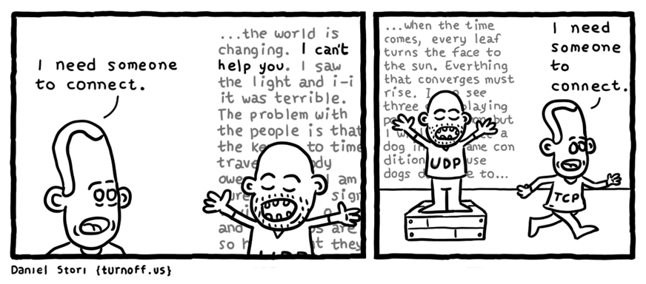

Slide 5
UDP Packet structure
Why use packet headers, as opposed to JSON?
Header information:
Source and destination ports for demux
Checksum for error detection
Packet length in bytes (headers and data)
UDP Packet Format
src_port
dst_port
Where are source and destination IP addresses?
length
checksum
Application
data
(message)
Why not send fixed length packets?
Data in 16-bit words
1 1 1 0 0 1 1 0 0 1 1 0 0 1 1 0
+ 1 1 0 1 0 1 0 1 0 1 0 1 0 1 0 1
= 1 1 0 1 1 1 0 1 1 1 0 1 1 1 0 1 1
+ 1
= 1 0 1 1 1 0 1 1 1 0 1 1 1 1 0 0
1
0 1 0 0 0 1 0 0 0 1 0 0 0 0 1 1
32-bits
Error checking
Recompute at receiver
Add result to passed checksum
Error if not all zeros
Wrap around: add overflow
Form one’s complement
Notes:
Why headers?
Easier to process
Don’t need whole packet before forwarding processing
What happens when error in checksum?

Slide 6
UDP Checksum Exercise
UDP Packet Format
Consider the following bits
src_port
dst_port
0001001110001000
0001011101110000
0000000000010000
1010010001111101
0001010110010101
0001001011000110
0001000011010100
1000100101100101
0000010010101100
0110100100111010
Identify the fields of a UDP packet
length
checksum
Application
data
(message)
Is the UDP packet correct?
In practice UDP checksum includes fields from IP header
32-bits
0001001110001000 0001011101110000
0000000000010000 1010010001111101
0001010110010101 0001001011000110
0001000011010100 1000100101100101
0000010010101100 0110100100111010
Notes:
Sum: 0101 1011 1000 0011
Complement: 1010010001111100
Sum: 1110110110011100
One’s complement: 0001001001100011
No guarantee error checking at routers
Could get errors while packets are sitting in send buffers

Slide 7
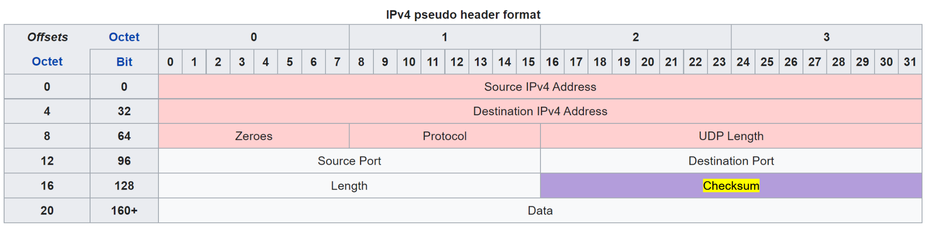
UDP header and pseudo IP header
In practice UDP checksum includes routing information
RFC 768 defines UDP checksum calculation
Includes fields in the pseudo IPv4 (or IPv6) header available to in the UDP socket
RFC 768: “This information gives protection against misrouted datagrams.”

Slide 8
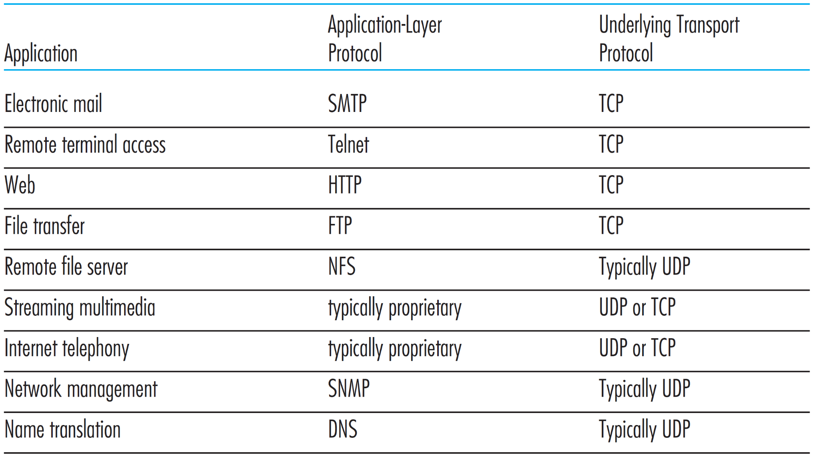
Which transport protocol where?
Email size > UDP packet size
In order delivery
Large pages
Large file sizes
High rate of transfer
Fixed data rate
Fixed data rate
No connection delay
No connection delay

Slide 9
User Datagram Prot. (UDP)
“No frills,” “bare bones” Internet transport protocol
Based on “best effort” network model
UDP segments can be lost
Or delivered out-of-order
Connection-less
No support for:
Flow control
Congestion control
In-order delivery
Reliability
Advantages of UDP:
Immediate transmission
No connection establishment
No delayed transmission
Fixed/immediate sending rate
No ramp up
Lower memory requirements
No connection state
Small packet overhead
8B for UDP vs 20B for TCP
Disadvantages:
Controversial in streaming applications
Blocked by many firewalls
Notes:
Mainly used for control traffic – where service the same for all clients

